Slide 1
Digital Portfolio
STUDENT NAME:PRAGATHI P
REGISTER NO AND NMID:2413106180252057/F064045745D34FF904943EB17A753990
DEPARTMENT: Bsc.COMPUTER SCIENCE
COLLEGE: COLLEGE/ UNIVERSITY:SHREE RAGHAVENDRA ARTS AND SCIENCE COLLEGE

Slide 2
PROJECT TITLE:
PORTFOLIO WEBPAGE

Slide 3


AGENDA
Problem Statement
Project Overview
End Users
Tools and Technologies
Portfolio design and Layout
Features and Functionality
Results and Screenshots
Conclusion
Github Link
3/21/2024 Annual Review

Slide 4

PROBLEM STATEMENT:
Many professionals struggle to showcase their skills effectively. This project creates a responsive portfolio website for Pragathi to present his work, projects, and contact details in a professional way.

Slide 5

PROJECT OVERVIEW
This project is a personal portfolio website for Pragathi, designed using HTML, CSS, and JavaScript. It highlights his skills, showcases projects, and provides a simple contact form, offering an interactive and professional online presence.

Slide 6

WHO ARE THE END USERS?
*Recruiters & Hiring Managers
*Clients
*Peers & Collaborators
*General Audience

Slide 7

TOOLS AND TECHNIQUES
* HTML
*CSS
*JAVA SCRIPT
* VS CODE

Slide 8
POTFOLIO DESIGN AND LAYOUT
-------------------------
| Logo About Projects Contact |
-------------------------
[ HERO ]
Hello, I’m Pragathi
Web Developer 🚀
[ View My Work ]
[ ABOUT ]
[Profile Image]
Short bio
[ PROJECTS ]
[Project 1] [Project 2]
[Project 3]
[ CONTACT ]
Name | Email | Message
[ Send Button ]
[ FOOTER ]
© 2025 pragathi
-------------------------
8

Slide 9
FEATURES AND FUNCTIONALITY
Navbar – Sticky navigation bar with smooth scrolling and mobile-friendly menu.
Hero Section – Full-screen introduction with typing effect and call-to-action button.
About Section – Profile image and a short bio highlighting skills and experience.
Projects Section – Grid-based cards showcasing projects with hover effects.
Contact Section – Simple form for users to send messages.
Footer – Minimal footer with copyright

Slide 10
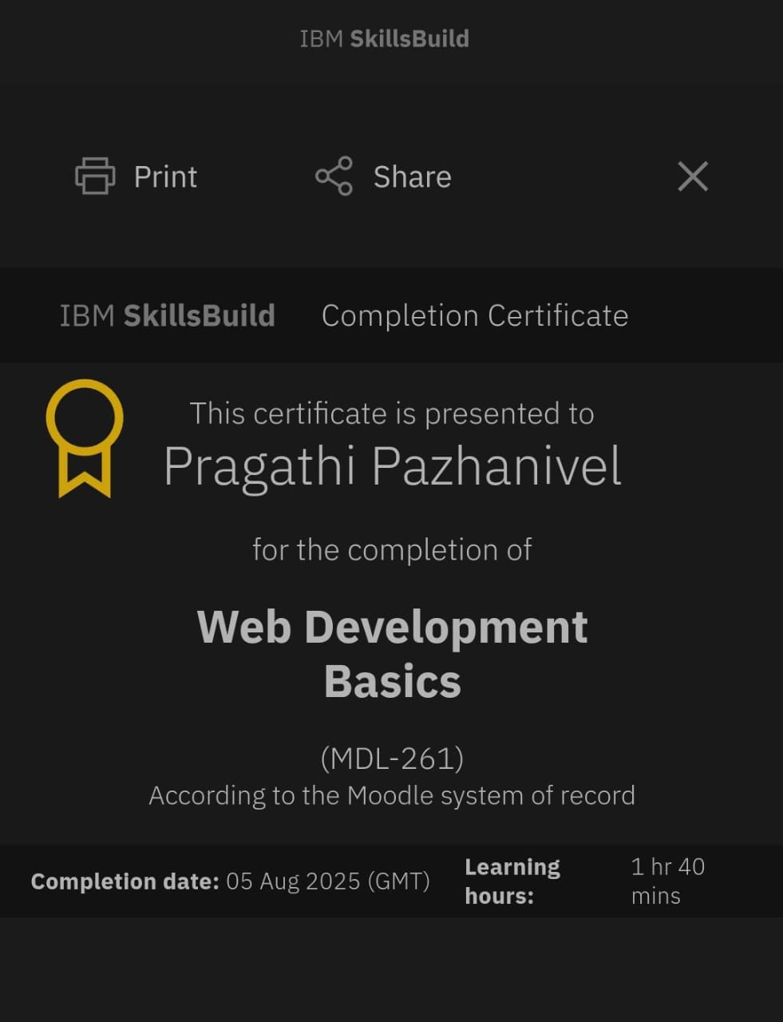
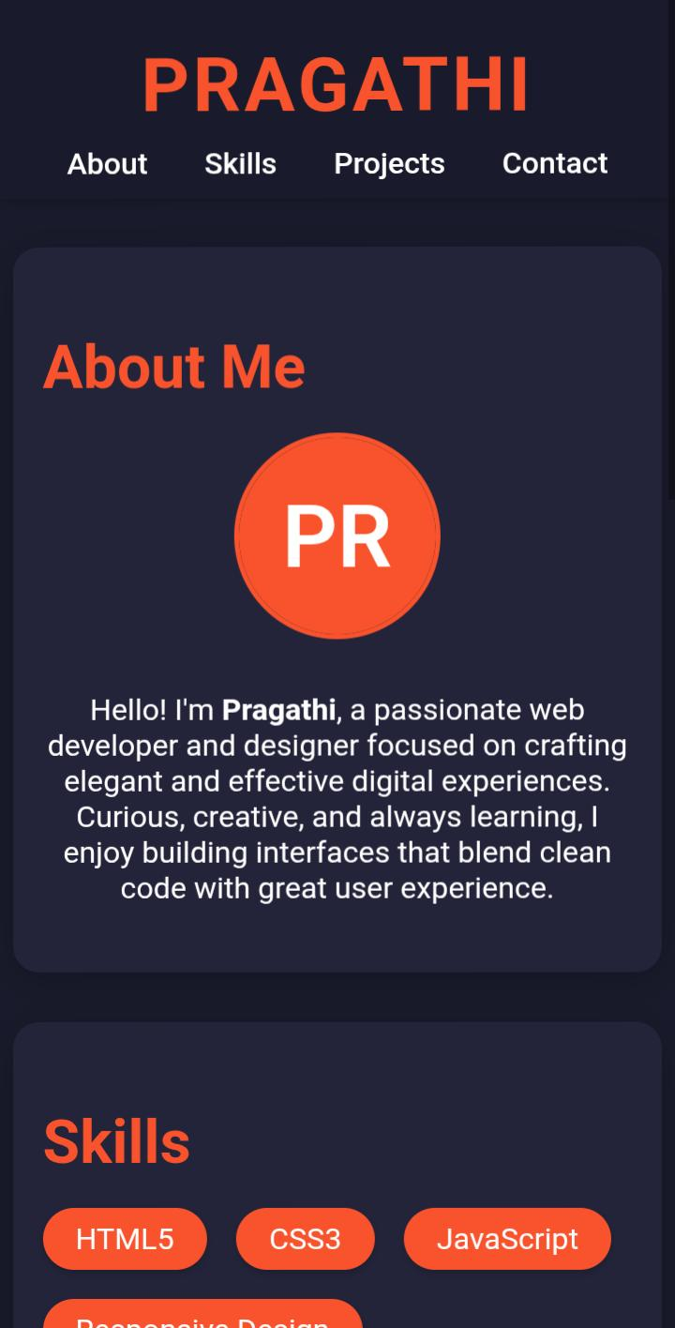
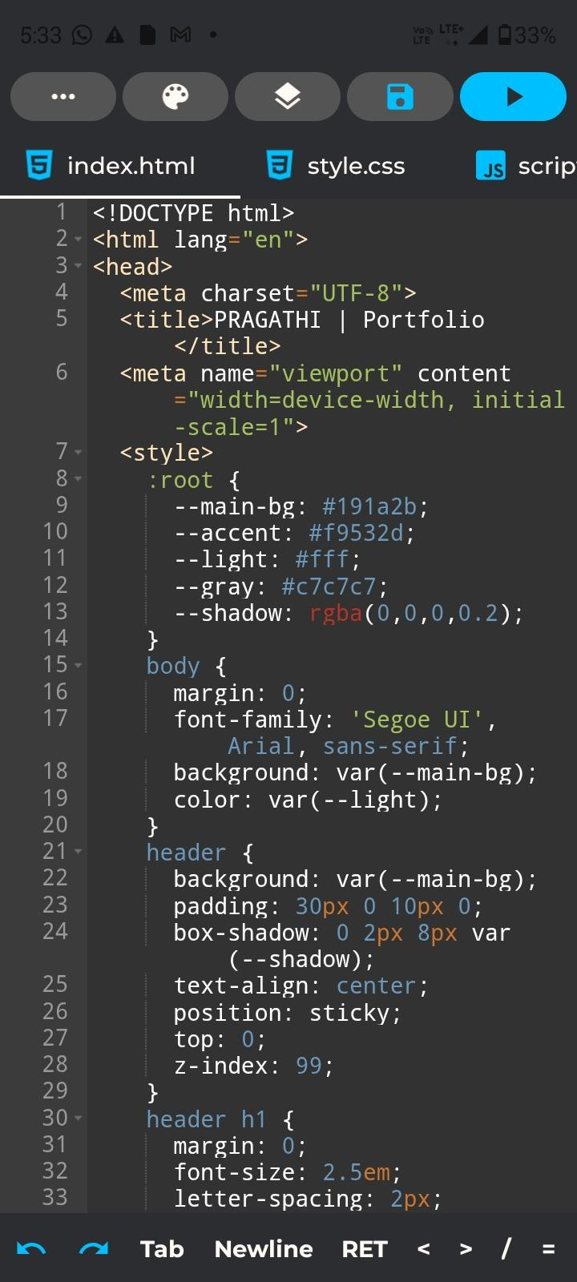
RESULTS AND SCREENSHOTS
3/21/2024 Annual Review
10

Slide 11
CONCLUSION
This portfolio website provides a professional platform for Pragathi.Pto showcase his skills, projects, and experience. With its responsive design, clean layout, and interactive features, it helps recruiters, clients, and collaborators easily connect with him. The project successfully demonstrates the use of HTML, CSS, and JavaScript to build a modern and functional personal website.
11

